Slide 1
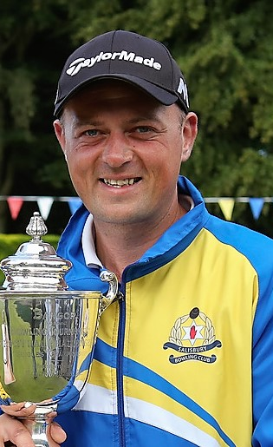
Bangor Open Singles
2022
Gary Eaton Jun (Salisbury )
Gary Eaton Jun 12 v 2 Matt Stevenson Castle
Semi
Gary 8 V 5 Glen Brown Ards
Matt 9 V 8 Matthew Crawford Bangor
Quarter
Gary 10 V 7 Ronan Cregan Lurgan
Matt 13 V 11 Robert Jervis Pickie
Glen 10 V 5 Adam McKeown Old Bleach
Matthew

Slide 2


Bangor Open Singles
2019
Gary Eaton Jun ( Salisbury )
Final :- Gary v Jim Corry ( Castle )
Semi Gary 12 v 4 Derek Wright ( Banbridge )
Jim 11 v 2 Thomas McClean ( Bangor )
Quarter
Gary 10 v 9 James McKenny ( Dromore )
Jim 8 v 7 David Black ( Knock )
Derek 9 v 4 David McRandal ( Larne )
Thomas 14 v 6 Alan Stewart ( Bangor )
This Photo by Unknown Author is licensed under CC BY-ND

Slide 3
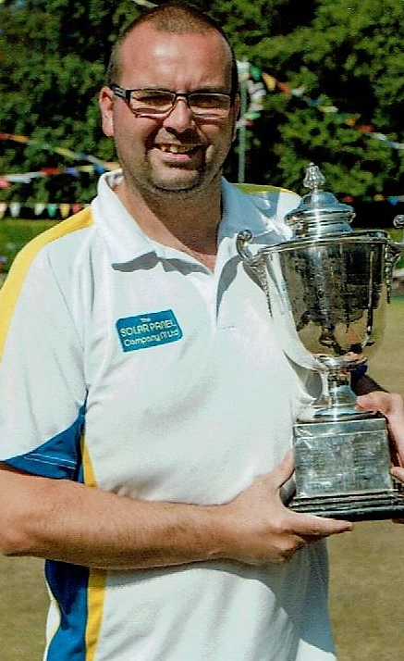
Bangor Open Singles
2018
Thomas Canavan ( Bangor)
Final
Thomas 8 v 5 Rodney Simpson
( North Down )
This Photo by Unknown Author is licensed under CC BY-ND

Slide 4
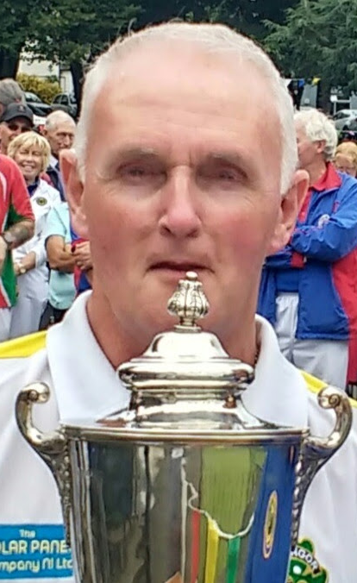
Bangor Open Singles
2017
Robert Hastings ( Bangor )
Final
Robert 13 v 3 David Ball ( Donaghadee )
Semi Robert 16 v 4 Jackie Erskine ( Bangor )
David 15 v 6 Ali Coleman ( Ballymena )
Quarter Robert 10 v 9 Gary Eaton jun ( Salisbury )
David 13 v 6 Gary Balentine ( Pickie)
Jackie 11 v 4 Elaine Hastings (Ballywalter)
Ali 13 v 7 Thomas McClean ( Bangor )
This Photo by Unknown Author is licensed under CC BY-ND

Slide 5
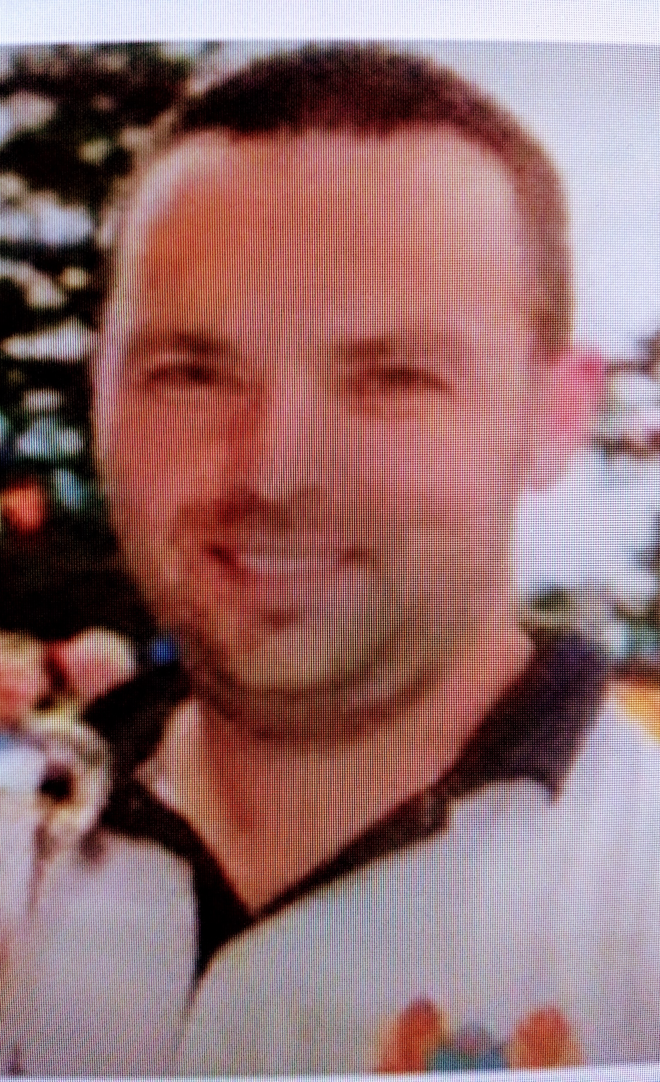
Bangor Open Singles
2016
Simon Cavan ( Belmont )
Final
Simon 15 v 5 David Black ( Knock )
Semi Simon 13 v 3 Graham McKee ( Bangor )
David 14 v 12 Ali Coleman ( Ballymena )
Quarter Simon 12 v 8 Maurice McKeown ( Castle )
David 15 v 13 Darren Witherspoon ( Whitehead)
Graham 15 v 8 Alec Lightbody ( Pickie )
Ali 15 v 6 Thomas Cannavan ( Bangor )
This Photo by Unknown Author is licensed under CC BY-ND

Slide 6
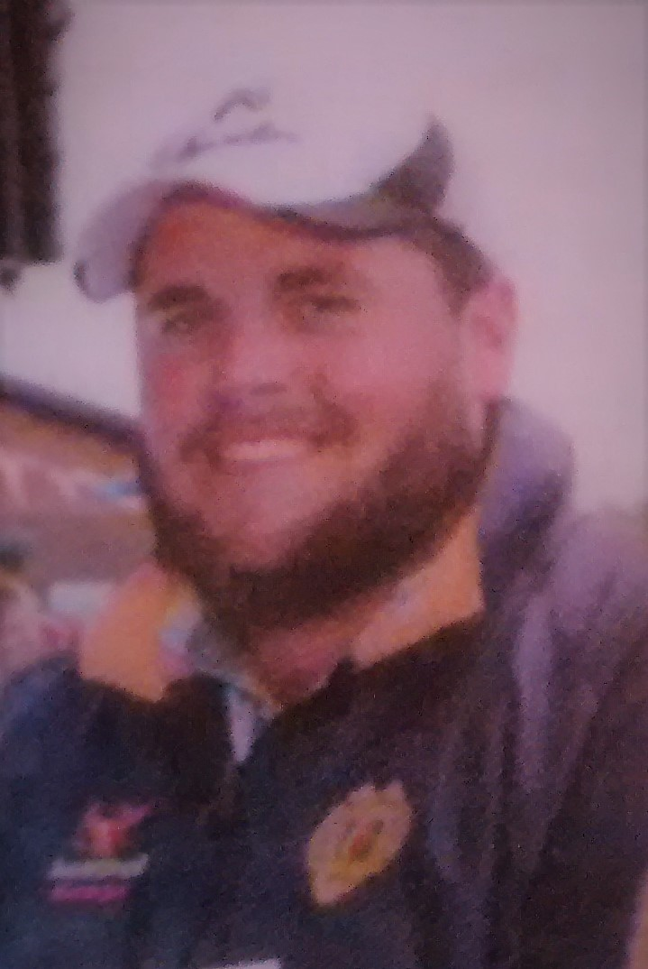
Bangor Open Singles
2015
Gary Kelly ( Ballymoney )
Final Gary 17 v 3 Ali Coleman (Ballymena)
Semi Gary 19 v 3 Alan McClean ( Whitehead )
Ali 14 v 7 Chris Mackender ( Castle )
This Photo by Unknown Author is licensed under CC BY-ND

Slide 7
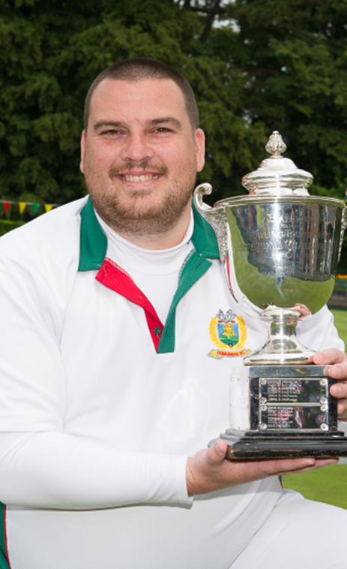
Bangor Open Singles
2014
Erick Kennedy (Donaghadee)
Final Erick 20 v 8 Peter Campbell ( Pickie)
Semi Erick 20 v 11 Alan Stewart ( Bangor )
Peter 22 v 9 Pat McRandal ( Whitehead )
This Photo by Unknown Author is licensed under CC BY-ND

Slide 8
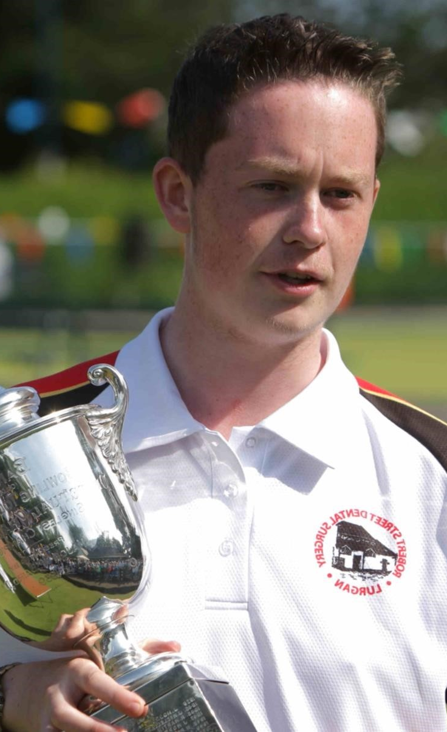
Bangor Open Singles
2013
Kristofor Matchett ( Lurgan )
Final
Kristofor 15 v 12 David Black ( Unattached )
Semi Kristofor v Brian Jess ( Downpatrick )
David v James McKenny ( Dromore )
Quarter Kristofor 16 v 7 Keith Taylor ( Bangor )
David 18 v 12 Sam McWilliams ( North Down)
Brian 13 v 10 Graham McKee ( Bangor)
James 17 v 11 David Ball ( Donaghadee )
This Photo by Unknown Author is licensed under CC BY-ND

Slide 9
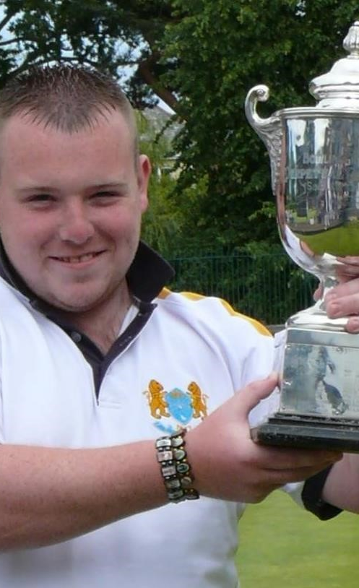
Bangor Open Singles
2012
Terry Crawford ( Belmont)
Final Terry v Neil Belch ( Pickie )
Semi Terry v Ryan Cavan ( Pickie)
Neil v David Cavan ( Pickie )
Quarter Terry 16 v 10 Thomas Cannavan ( Bangor)
Neil 13 v 11 Gary Eaton jun (Salisbury)
Ryan 19 v 10 Maurice McKeown ( Bangor)
David 13 v 8 Simon Beggs ( Larne)
This Photo by Unknown Author is licensed under CC BY-ND

Slide 10
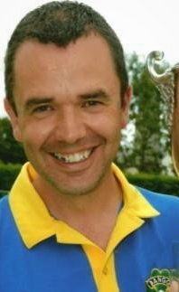
Bangor Open Singles
2011
Simon Martin ( Bangor )
Final Simon 22 v 9 Clifford Bailie ( Knock)
Semi Simon 15 v 10 Tony Bell (Dunbarton )
Clifford 16 v 11 Darren Witherspoon ( Curran)
Quarter Simon 15 v 12 Gary Ballentine ( Pickie )
Clifford 18 v 7 Elaine Hastings ( Ballywalter )
Tony 17 v 5 Scott Jess ( Dromore )
Darren 15 v 4 Gemma McClean ( Pickie )
This Photo by Unknown Author is licensed under CC BY-ND

Slide 11
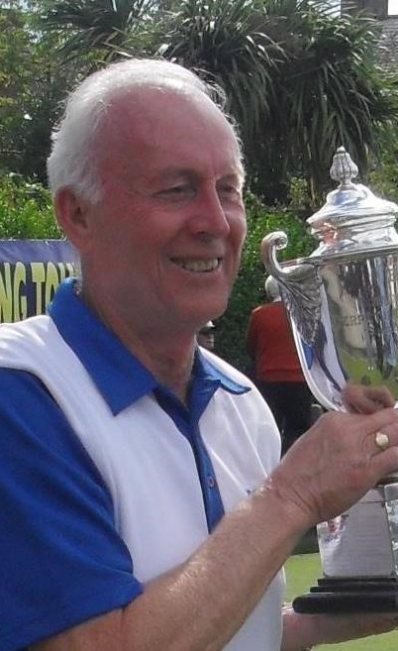
Bangor Open Singles
2010
James Miller ( Willowfield )
Final James 14 v 11 Nigel Todd ( Curran )
Semi James 13 v 12 Matt Stevenson ( Castle )
Nigel 20 v 6 Mairead McGuigan ( Ewarts )
This Photo by Unknown Author is licensed under CC BY-ND

Slide 12
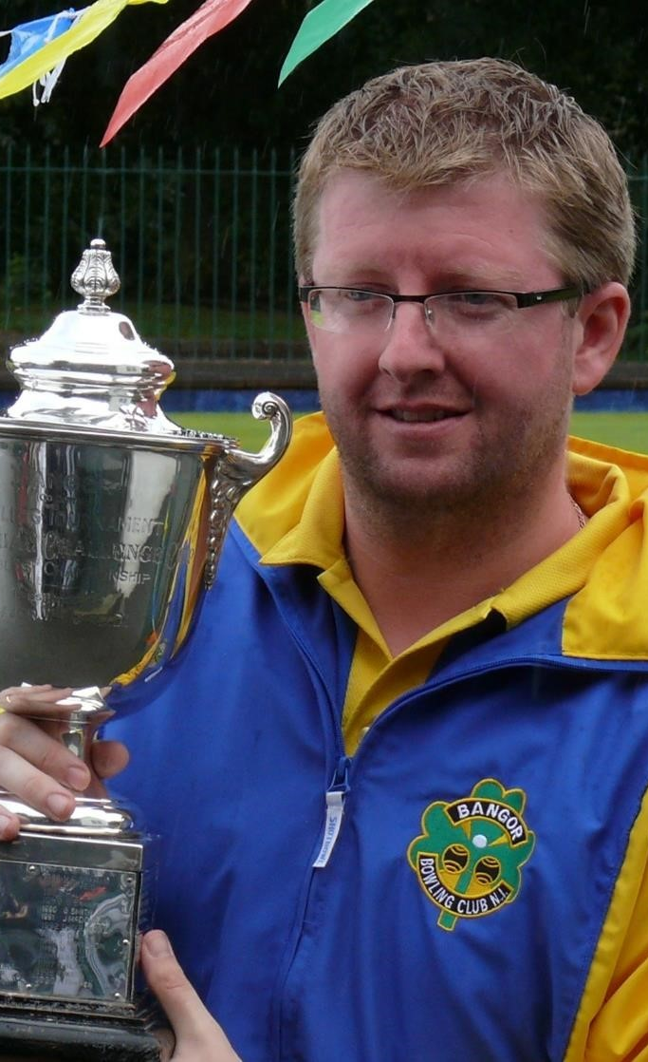
Bangor open Singles
2009
Barry Quinn ( Bangor )
Final Barry 17 v 10 James McKenny ( Dromore)
Semi Barry 13 v 8 Fred Thompson (Willowfield)
James 15 v 9 William Haddock
Quarter Barry 15 v 9 George Richardson (Portadown)
James 21 v 7 Harry Kerr ( Castle )
Fred 16 v 11 James Burns ( Whitehead ))
William 16 v 10 Simon Martin ( Bangor)
This Photo by Unknown Author is licensed under CC BY-ND

Slide 13
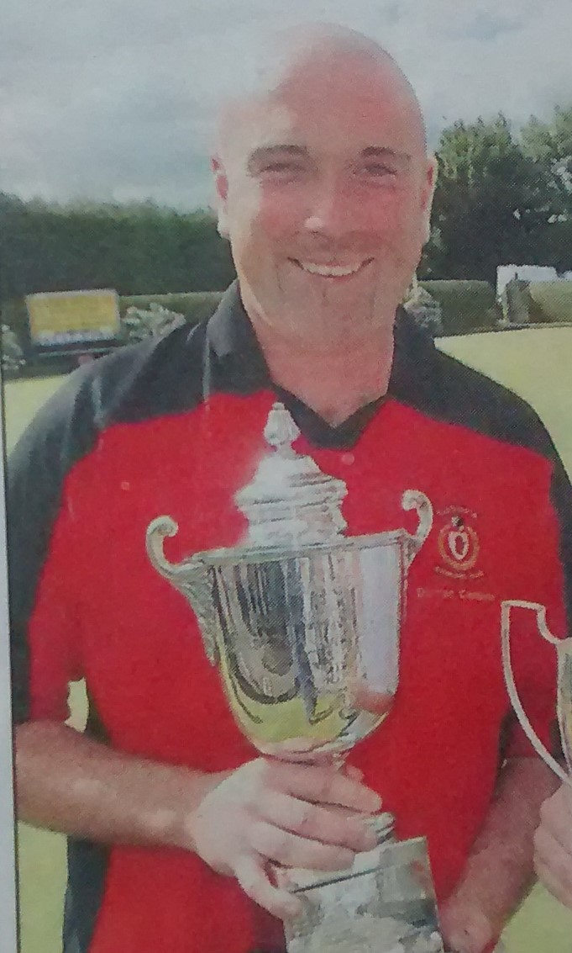
Bangor Open Singles
2008
Darren Cameron ( Victoria Park )
Final Darren V Simon Martin ( Bangor )
This Photo by Unknown Author is licensed under CC BY-ND

Slide 14
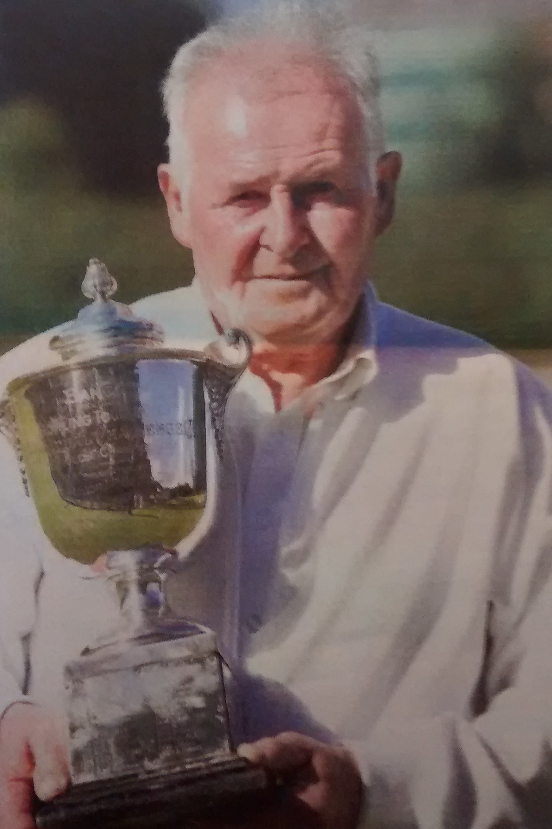
Bangor Open Singles
2007
James McKenny ( Dromore )
Final James 21 v 7 Simon Cavan ( Pickie )
Semi James 21 v 17 Pat McRandal
Simon 21 v 6 Graham McKee ( Bangor )
This Photo by Unknown Author is licensed under CC BY-ND

Slide 15
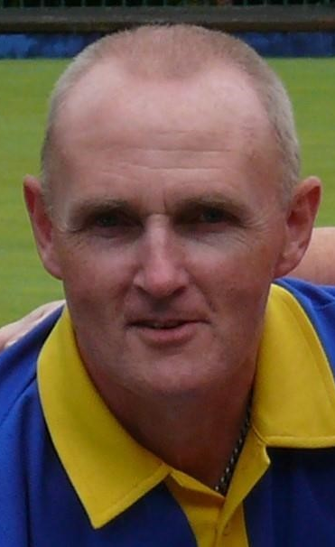
Bangor Open Singles
2006
Robert Hastings ( Bangor )
Final Robert 21 v 20 Paul Consiglia
( Londonderry Park )
This Photo by Unknown Author is licensed under CC BY-ND

Slide 16
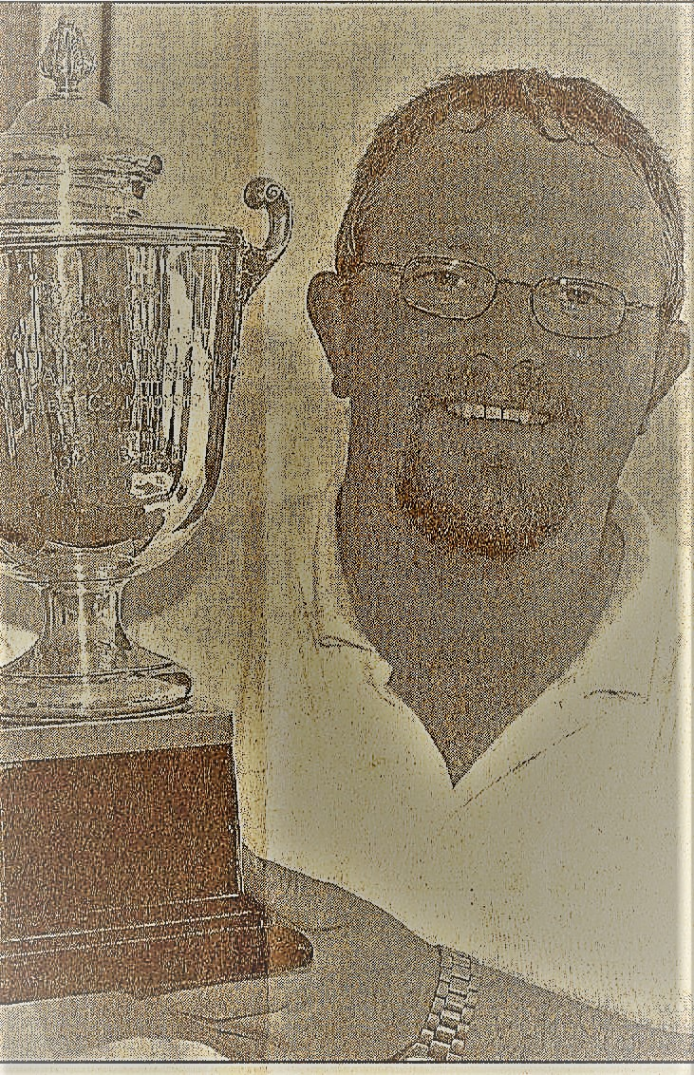
Bangor Open Singles
2005
David McRandal ( Larne )
Final David 21 v 14 Robert Hastings ( Bangor )
This Photo by Unknown Author is licensed under CC BY-ND

Slide 17
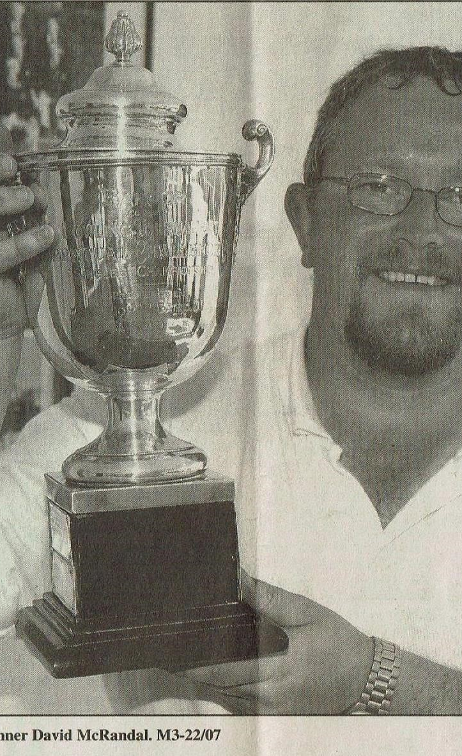
Bangor Open Singles
2004
David McRandal ( Larne )
Final David 21 v 20 Gary Scott ( Bangor )
This Photo by Unknown Author is licensed under CC BY-ND

Slide 18
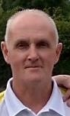
Bangor Open Singles
2003
Robert Hastings ( Bangor )
Final Robert 21 v 9 Sandy Dalzell
( North Down )
This Photo by Unknown Author is licensed under CC BY-ND

Slide 19
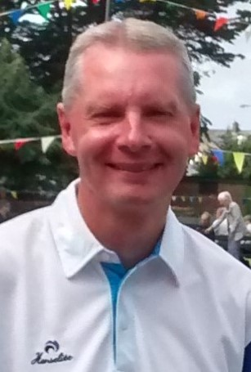
Bangor Open Singles
2002
Andrew Hughes ( Portadown )
Final Andrew 21 v 9 Sandy Dalzell
( North Down )
This Photo by Unknown Author is licensed under CC BY-ND

Slide 20
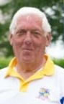
Bangor Open Singles
2001
Jackie Nelson ( Bangor )
Final Jackie 21 v 14 Geoff McMullan
( Portadown )
This Photo by Unknown Author is licensed under CC BY-ND

Slide 21
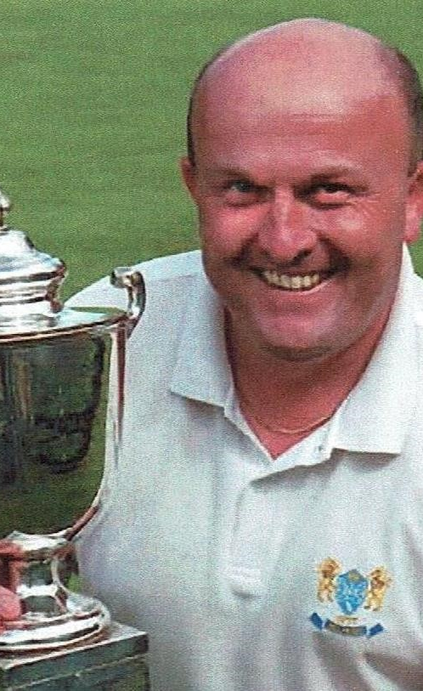
Bangor Open Singles
2000
Robin Horner ( Belmont )
Final Robin 21 v 2 Len Smeaton (Belmont)
Semi Robin 21 v 15 Terry Deconink (Park Drive )
Len 21 v 13 H Magee
This Photo by Unknown Author is licensed under CC BY-ND

Slide 22
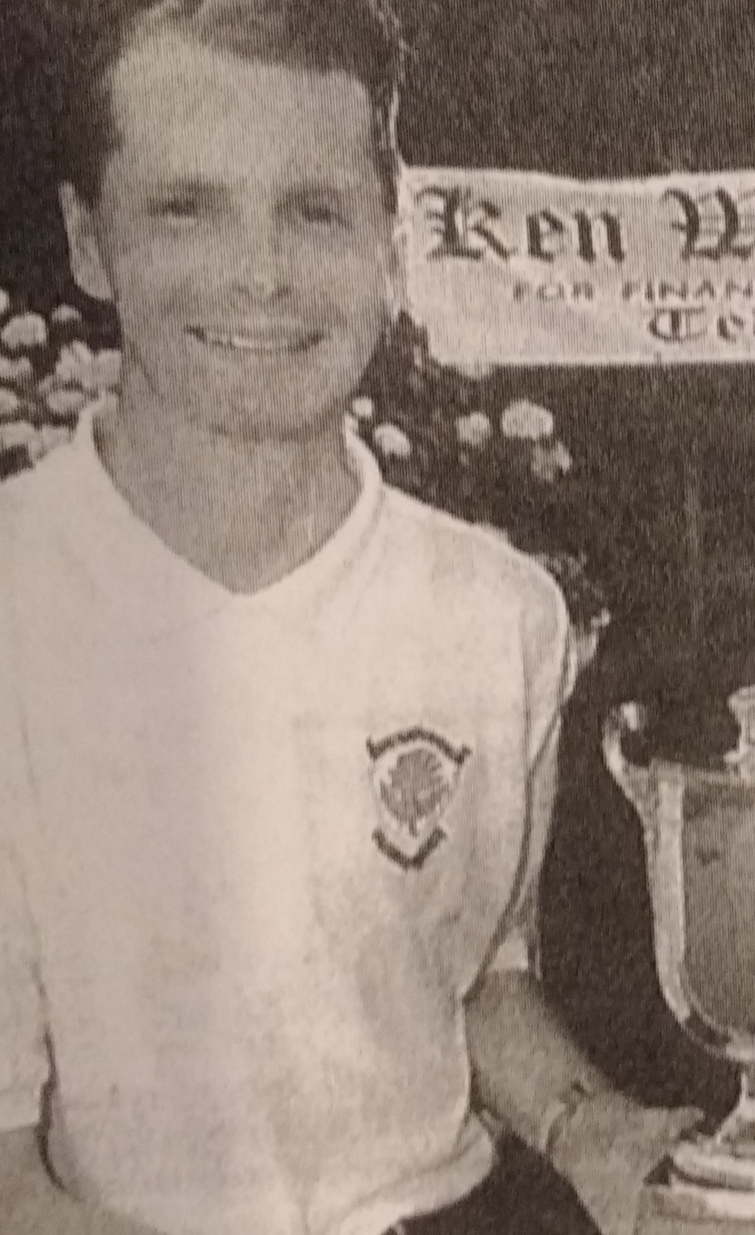
Bangor Open Singles
1999
Andrew Hughes ( Portadown )
Final Andrew v Neil Belch ( Pickie )
Semi Andrew 21 v 20 Tom McMullan ( Dunluce )
Neil 21 v 14 Peter Black ( NICS )
This Photo by Unknown Author is licensed under CC BY-ND

Slide 23
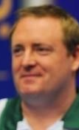
Bangor Open Singles
1998
Jonathon Ross ( Lisnagarvey )
Final Jonathon v Neil Belch ( Pickie )
Semi Jonathon 21 v 13 Rodney McCutcheon
Neil 21 v 19 Andrew Hughes
( Portadown )
This Photo by Unknown Author is licensed under CC BY-ND

Slide 24
Bangor Open Singles
1997
Peter Black ( NICS )
Final Peter v Tommy Reeves (Gallagher's)
Don’t have photo for Peter Black if you can help it would be good
This Photo by Unknown Author is licensed under CC BY-ND

Slide 25
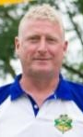
Bangor Open Singles
1996
Gary Scott ( Bangor )
Final Gary v Simon Denley ( Bangor )
This Photo by Unknown Author is licensed under CC BY-ND

Slide 26
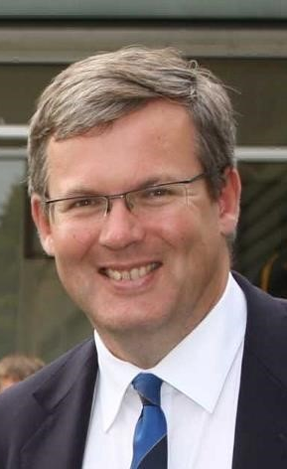
Bangor Open Singles
1995
Micheal Nutt ( Portrush )
Final
This Photo by Unknown Author is licensed under CC BY-ND

Slide 27
Bangor Open Singles
1994
Leslie Wilson ( Bangor )
Final
This Photo by Unknown Author is licensed under CC BY-ND

Slide 28
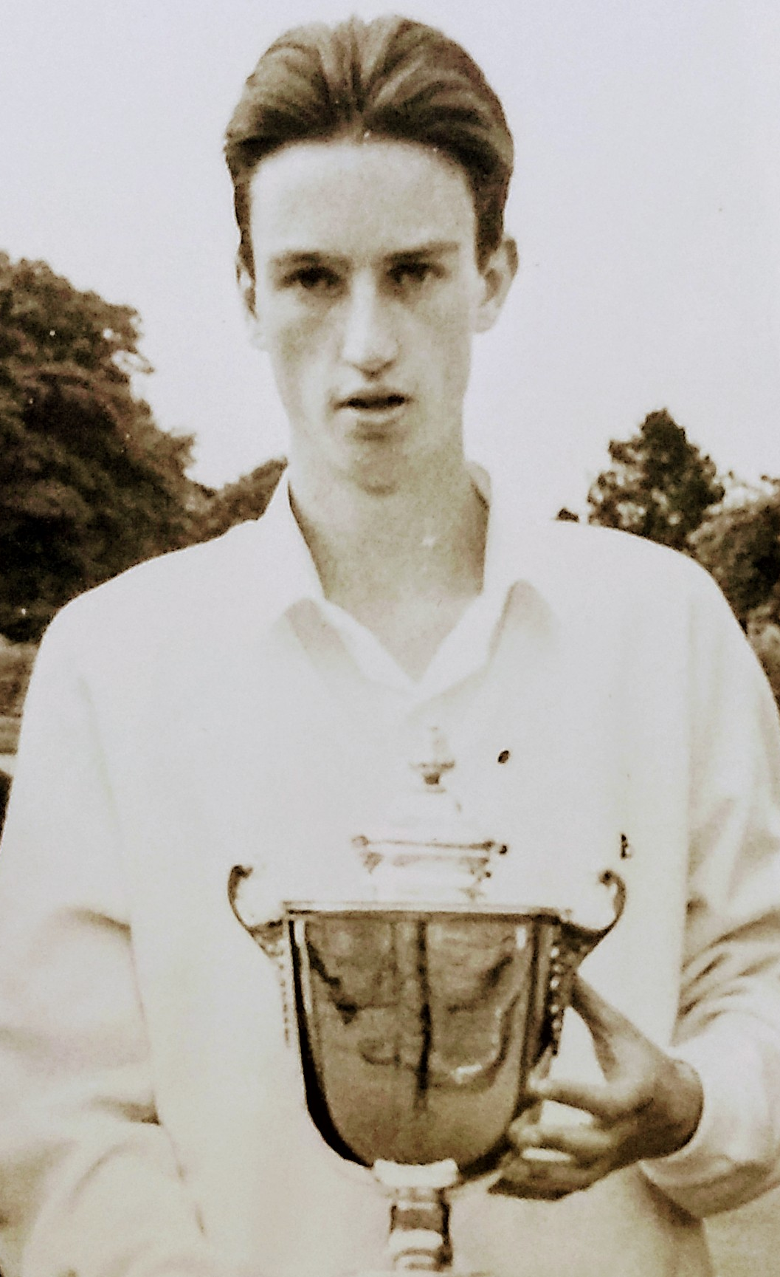
Bangor Open Singles
1993
Paul Daly ( Belmont )
Final Paul 21 v 20 Keith Taylor ( Bangor )
Semi Paul 21 v 20 Mark McPeak ( NICS )
Keith 21 v 8 Gary Scott ( Bangor )
This Photo by Unknown Author is licensed under CC BY-ND

Slide 29
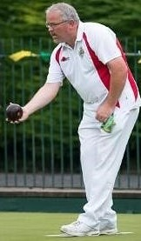
Bangor Open Singles
1992
David McRandal ( Larne )
Final
This Photo by Unknown Author is licensed under CC BY-ND

Slide 30
Bangor Open Singles
1991 John McDowell ( Knock )
1990 Gary Smith ( Bangor )
1989 Stephen Branniff (Musgrave )
1988 Sam Hall ( Old Bleach )
1987 Paul McVeigh ( Falls )
1986 Mark Graham ( Bangor )
1985 Eddie McNally ( Falls )
1984 Rodney McCutcheon ( Bangor)
1983 David Gardner ( Belmont )
1982 B Livingston
1981 Carl Gibson ( Castle )
1980 Maurice McKeown ( Bangor )
1979 Maurice McKeown ( Bangor )
1978 William McKelvey ( Bangor )
1977 George Madine ( Albert Foundry )
1976 Sandy Smith + 1974 ( Knock ) + 1963
This Photo by Unknown Author is licensed under CC BY-ND

Slide 31
Bangor Open Singles
1975 Stanley Espie ( Falls )
1974 Sandy Smith + 1963 ( Knock ) + 1976
1973 Tommy Reeves Gallagher's V George Madine ( Albert Foundry )
1972 Fergus McConkey ( Donaghadee ) 1964 & 1968
1971 A Johnston
1970 Hugh Wallace ( Carrickfergus )
1969 Jackie Harris ( Castle )
1968 Fergus McConkey ( Donaghadee )
1967 Tom O’Neil ( Woodvale ) ?
1966 Dispute with Council Greens not used that year
1965 Tom Nixon ( Willowfield )
1964 Fergus McConkey ( Donaghadee )
1963 Andy Smith ( Knock ) 1974 + 1976
1962 D Pollock ( Knock )
1961 J P McCavana + 1956
1960 J McDonald
This Photo by Unknown Author is licensed under CC BY-ND

Slide 32
Bangor Open Singles
1959 W S Tate + 1954 ( Newcastle )
1958 V Elliott
1957 A Duggan
1956 J P McCavana +1961
1955 Jim Sloan ( Cliftonville )
1954 W S Tate + 1959 ( Newcastle )
1953 B Fitzmaurice ( Cliftonville )
1952 John McCelland ( Pickie ) 1951 + 1945
1951 John McCelland ( Pickie )
1950 No Tournament
1949 No Tournament
1948 William Pollack ( Castle )
1947 No Tournament
1946 No Tournament
1945 John McCelland ( Pickie )
1939 Jack Morrow ( Bangor )
This Photo by Unknown Author is licensed under CC BY-ND

Slide 33
Bangor Open Singles
This Photo by Unknown Author is licensed under CC BY-ND

Slide 34
Bangor Open Singles
This Photo by Unknown Author is licensed under CC BY-ND

Slide 35
Bangor Open Singles
This Photo by Unknown Author is licensed under CC BY-ND

